Slide 1

Basic Details of the Team and Problem Statement
Ministry/Organization Name/Student Innovation : AICTE
PS Code : SIH1460
Problem Statement Title : Integration of AI for Adaptive Learning for MCQ Selection in PARAKH
Team Name : Tech Classifierz
Team Leader Name :Bhuvanika S
Institute Code (AISHE):C-27058
Institute Name:Mepco Schlenk Engineering College, Sivakasi
Theme Name:Smart Automation

Slide 2
Proposed Idea/Solution/Prototype
We are looking for a solution by developing a software The project is to develop a web-based adaptive multiple-choice question (MCQ) testing system that delivers MCQ assessments to users over the internet and adapts the questions based on the user's performance and abilities.. This prototype functions as follows:
User Input : Users log in to the software ,need to select domains ,topics and take assessment.
Initial Assessment : All students start with a common set of questions to find their performance.
Score-Based Sorting : Students are categorized as toppers, average performers, or weaker students based on their performance. Students performance can be measured by time taken,and previous result
Data collection : The first step is to collect a dataset of MCQs from PARAKH exams.Once the data is collected, it needs to be preprocessed.
Question Preprocessing : The translated English text undergoes preprocessing, including tokenization,word embedding for further processing.
Word Embedding : The preprocessed questions are undergoes word embedding technique.It is a way to represent words and whole sentences in a numerical manner. This makes it possible for computers to understand the meaning of text and perform tasks such as natural language processing (NLP).
Question Training : Train the preprocessed question using LSTM.Use the trained LSTM model to predict the difficulty of new questions. To do this, simply feed the new questions to the LSTM model as input. The LSTM model will then output a prediction of the question's difficulty level.
Suggestion of Questions : Suggestion questions based on their capability using Adaptive algorithm. This is done by tracking the test-taker's performance on previous questions and selecting the next question accordingly.
Technology Stack
ReactJs: For creating front-end.
LSTM: Used for predicting difficulty of questions.
Adaptive Algorithm: Used for generating questions based on student’s capability.
Mongodb: Used for storing student’s details.
Prototype Status
70% of the software developed and further development is on progress. Testing and validation process are next to be undergone.

Slide 3
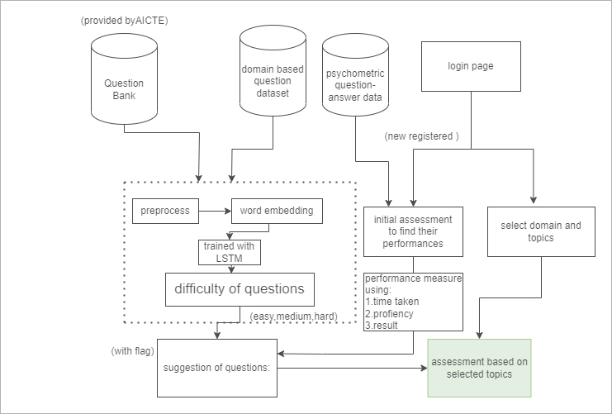
FLOW DIAGRAM

Slide 4
Use Cases
Dependencies
Self-paced learning: The adaptive MCQ testing system can be used to create a self-paced learning environment for students. Students can take the assessments at their own pace and receive feedback on their performance. This can help students to learn at their own speed and in a way that is most effective for them.
Measure benchmark levels and gains in academic and higher-order thinking skills of students: The system can be used to measure students' academic and higher-order thinking skills by asking questions that assess their knowledge, understanding, and application of the material. The system can also track students' progress over time to identify areas where they are improving and areas where they need additional support.
Scalable to accommodate a large number of users: The system can be scaled to accommodate a large number of users by using cloud computing technologies. This means that the system can be accessed by students from anywhere in the world with an internet connection.
Identify students with high potential: The system can be used to identify students with high potential by asking questions that assess their critical thinking, problem-solving, and creative thinking skills. The system can also identify students who are excelling in particular subject areas.
MongoDB : The database will be used to store the questions, assessments, and user data.
JavaScript : The programming language will be used to develop the web application.
React : A framework will provide a set of tools and libraries that can be used to simplify the development of the web application
Show Stopper
Data quality : The dataset used to train the AI algorithm should be carefully curated to ensure that it is of high quality. The dataset should also be representative of the student population that the system will be used for.
Bias : The AI algorithm should be designed to be fair and unbiased. This can be done by using adversarial training.
Interpretability: The AI algorithm should be designed to be interpretable. This can be done by using techniques such as explainable AI.

Slide 5

Sample Screenshot of our Implemented Software

Slide 6
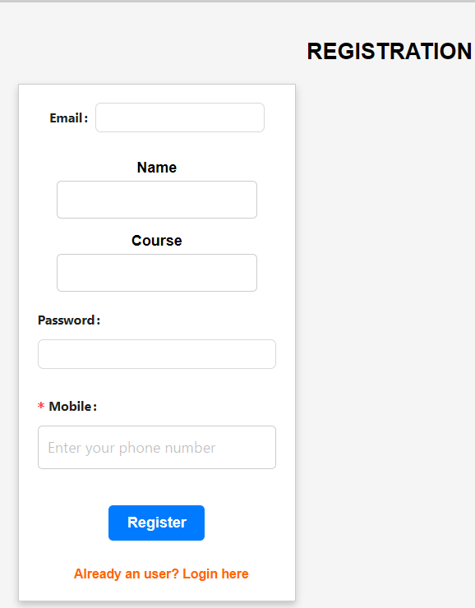
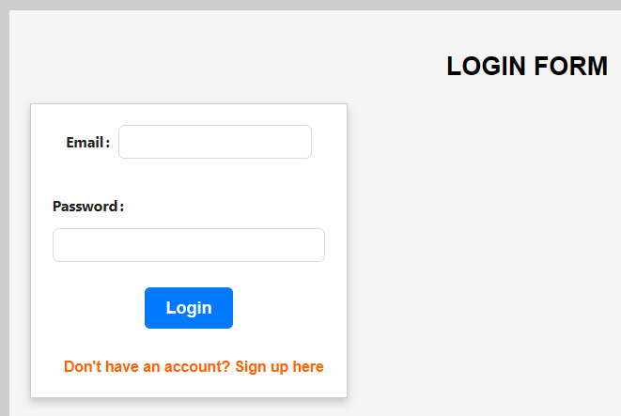

Slide 7
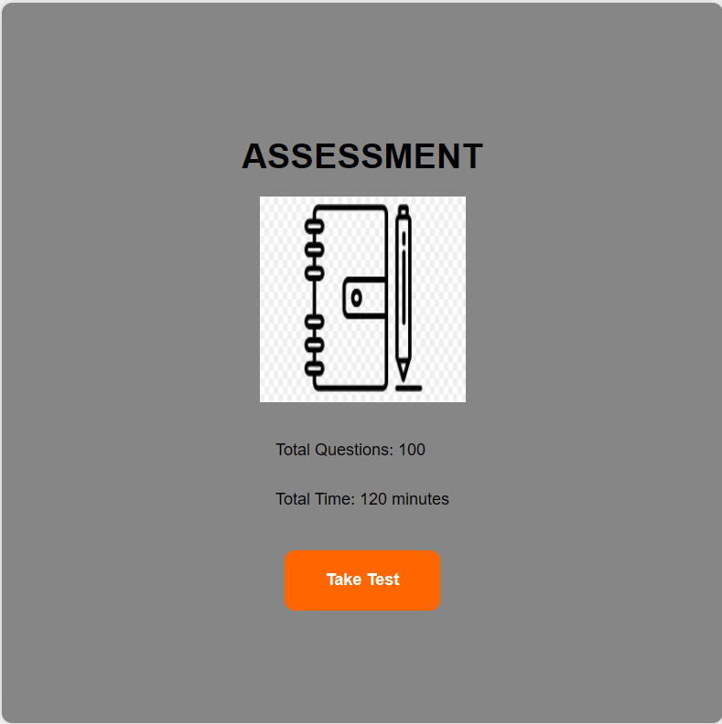
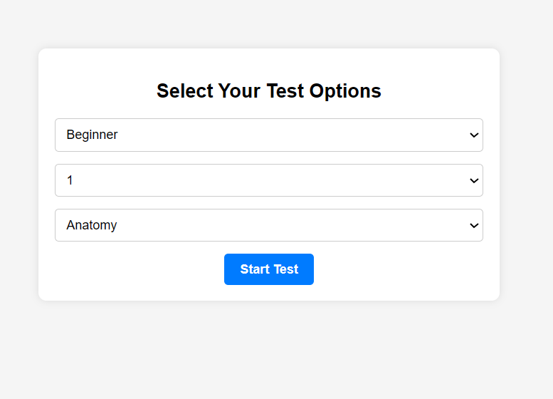

Slide 8


Slide 9
Team Member Details
Team Leader Name: Bhuvanika S
Branch : Btech Stream : AI&DS Year : III
Team Member 1 Name : Cibiksha V
Branch : Btech Stream : AI&DS Year : III
Team Member 2 Name : Jospar Millian J
Branch : Btech Stream : AI&DS Year : III
Team Member 3 Name: Keshavaram B S
Branch : Btech Stream : AI&DS Year : III
Team Member 4 Name : Rajakumari S
Branch : Btech Stream : AI&DS Year : III
Team Member 5 Name: Srewathi T K
Branch : Btech Stream : AI&DS Year : III
Team Mentor Name: Prasika L
Category : Academic Expertise : ML Domain Experience (in years): 6.21

